Slide 1
Linux device driver
Day 21 PPT
-SUBITHRA s

Slide 2
GRAPH
Graph
A graph can be defined as group of vertices and edges that are used to connect these vertices. A graph can be seen as a cyclic tree, where the vertices (nodes) maintain any complex relationship among them instead of having parent child relationship.
A graph G can be defined as an ordered set G(V, E) where V(G) represents the set of vertices and E(G) represents the set of edges which are used to connect these vertices.
A graph g(v, e) with 5 vertices (a, b, c, d, e) and six edges ((a,b), (b,c), (c,e), (e,d), (d,b), (d,a)) is shown in the following figure.

Slide 3
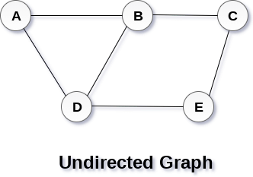
Undirected graph
An undirected graph, edges are not associated with the directions with them. An undirected graph is shown in the above figure since its edges are not attached with any of the directions. If an edge exists between vertex A and B then the vertices can be traversed from B to A as well as A to B.

Slide 4
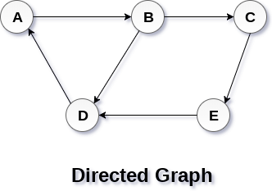
Directed graph
A directed graph, edges form an ordered pair. Edges represent a specific path from some vertex A to another vertex B. Node A is called initial node while node B is called terminal node.
A directed graph is shown in the following figure.

Slide 5
GRAPH
Nodes (vertices): nodes are the fundamental elements of a graph. Each node typically represents an entity or object, such as a person, place, or thing in a real-world scenario. In a graph, nodes are often denoted by circles or points.
Edges: edges are the connections or links between nodes in a graph. They represent relationships or interactions between the entities represented by the nodes. Edges can be directed or undirected, depending on whether the relationship between nodes has a specific direction.
Directed graphs (digraphs): in a directed graph, edges have a direction associated with them. This means that the connection between nodes is one-way, indicating a specific flow or relationship from one node to another. Directed graphs are useful for modeling scenarios like dependencies, networks with directional flows, and hierarchical structures.
Undirected graphs: in an undirected graph, edges do not have a direction. This means that the connection between nodes is bidirectional, indicating a symmetric relationship where the connection is mutual between the nodes. Undirected graphs are commonly used to represent relationships like friendships in social networks, communication links, or physical connections between objects.

Slide 6
GRAPH
Weighted graphs: in some graphs, edges are assigned weights or values that represent the cost, distance, or any other numerical measure associated with traversing that edge. Weighted graphs are useful for modeling scenarios where there are varying degrees of "cost" between nodes, such as in transportation networks, scheduling algorithms, or optimization problems.
Adjacency: the adjacency of nodes in a graph refers to whether they are directly connected by an edge. For example, in an adjacency list representation, each node stores a list of its neighboring nodes (adjacent nodes) to indicate which nodes are directly connected.
Graph representation: graphs can be represented using various data structures such as adjacency matrices or adjacency lists. An adjacency matrix is a 2D array where rows and columns represent nodes, and matrix cells indicate the presence or absence of edges between nodes. An adjacency list is a collection of lists or arrays where each node's list contains its adjacent nodes.

Slide 7
THANK YOU

